Slide 1
Reliable connectivity for a dime
Vamsi Talla, Mehrdad Hessar, Bryce Kellogg, Ali Najafi,
Joshua R. Smith and Shyamnath Gollakota

Slide 2
Ubiquitous Connectivity

Slide 3
What do we need to enable ubiquitous connectivity?
Cost
Power consumption
Size and form factor
Coverage and operating distances

Slide 4
Hypothesis: No technology exists today which satisfy these requirements
Active Radios
RFID
$2-$4 price point
Consumes 10-1000 mW
Incompatible with printed batteries & require external components
Wide area coverage including through wall propagation
Costs <10 cents
uW power budget
Small flexible sticker form factor & low peak currents
Short range and does not work through walls and obstacles
Can we get the best of both worlds?

Slide 5
First wireless system that operates at km distances while consuming less than 10 µW
Achieve data rate from 50 bps to 32.5 kbps
Whole home sensing, precision agriculture and implanted flexible medical devices applications

Slide 6
Backscatter Communication

Slide 7
Challenge: Signal Propagation in Backscatter Systems
RF Source
Receiver
d₁
$$P_{signal} ∝ \frac{1}{d_{1}^{2}d_{2}^{2}}$$
d₂
RF carrier
9
Backscatter Device

Slide 8
Challenge: Signal Propagation in Backscatter Systems
d
$$P_{blocker} ∝ \frac{1}{d2}$$
RF Source
Receiver
d₁
d₂
$$P_{signal} ∝ \frac{1}{d_{1}^{2}d_{2}^{2}}$$
Extremely low signal strength data packet and a strong blocker at the receiver
Backscatter Device

Slide 9
Our Solution: Clean slate design of backscatter system
Use coding to achieve optimal tradeoff between sensitivity and data rate
Modulation scheme resilient to single tone interference
Chirp Spread Spectrum Modulation
Decode signals down to -148 dBm
50 bps to 32.5 kbps data rates
Blocking immunity of 90 dB

Slide 10
Chirp spread spectrum modulation
Linearly vary the frequency of the carrier with time
$$freq$$
$$freq$$
$$f$$
$$f$$
$$N$$
$$t$$
$$t$$
$$0$$
$$N$$
$$0$$
$$−f$$
$$−f$$
Bit ‘0’
Bit ‘1’
Data is encoded in cyclic shifts of frequency

Slide 11
Synthesize CSS using backscatter
Linearly vary the frequency of the square wave at the backscatter switch

Slide 12
Synthesize CSS using backscatter
RF Source
Receiver
d₁
Extremely small, low power and cheap long range connectivity solution which can be embedded in every object
9
CSS Modulated Data packet
Backscatter Device

Slide 13
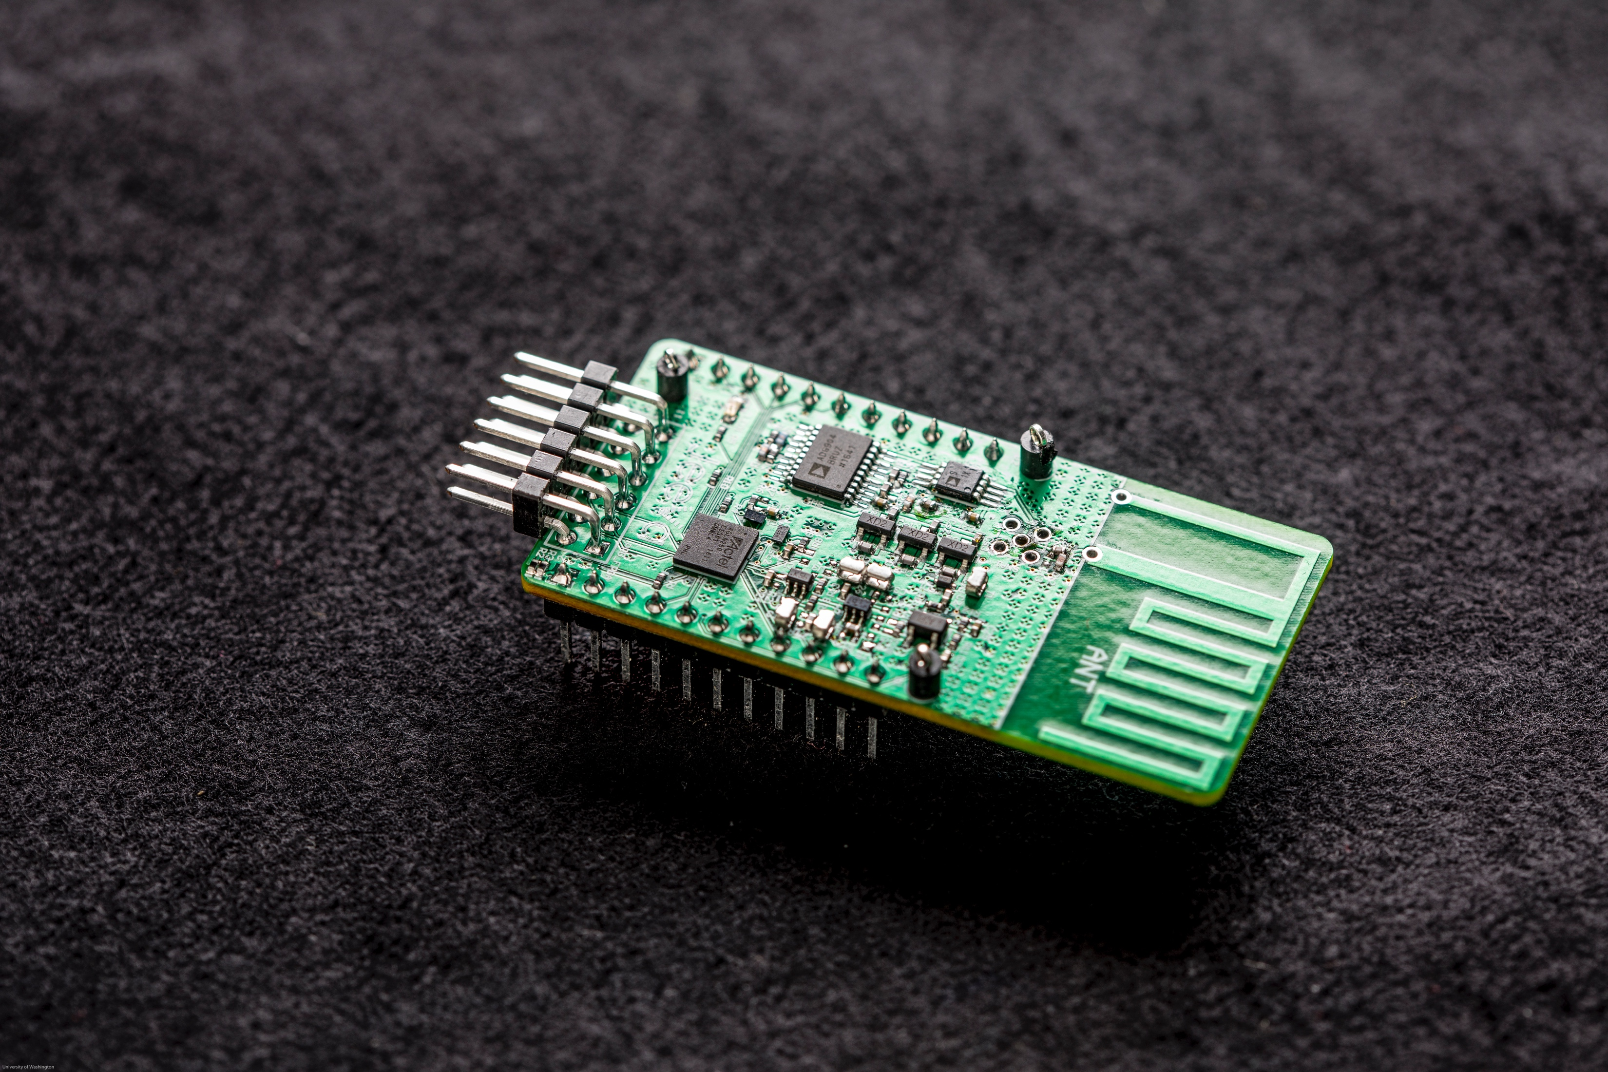
Implementation
COTS Prototype:
MicroSemi Igloo Nano FPGA
Custom RF backscatter switch
IC Implementation:
TSMC 65nm LP Process
Verilog baseband, RF switch & PLL
Consumes 9.5 µW during transmission

Slide 14
Evaluation
Tested our system in various wide area deployments including open roads/fields and Lake Washington.
When the RF source and receiver are separated by 475 m, the backscatter device can be placed anywhere between the two.
Backscatter device and RF source are co-located, the receiver can be as far as 2.8 km.

Slide 15
Live Demo

Slide 16
Applications
Wide area deployments:
Home & Office sensing
Precision Agriculture
Implanted & Medical devices:
Contact Lens
Epidermal Patch Sensors

Slide 17
Home and Office Sensing
Reliable Connectivity across
3 floor ~5000 ft² home
13,000 ft² office spread across 41 rooms

Slide 18
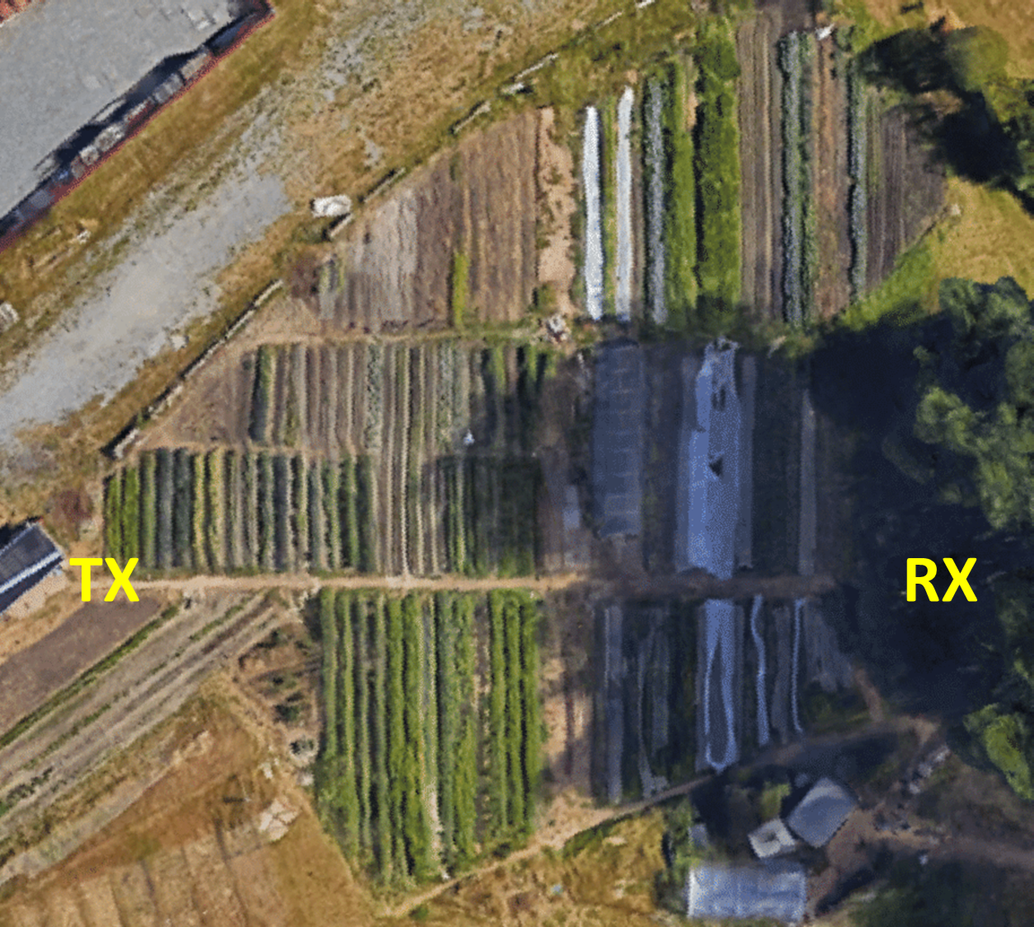
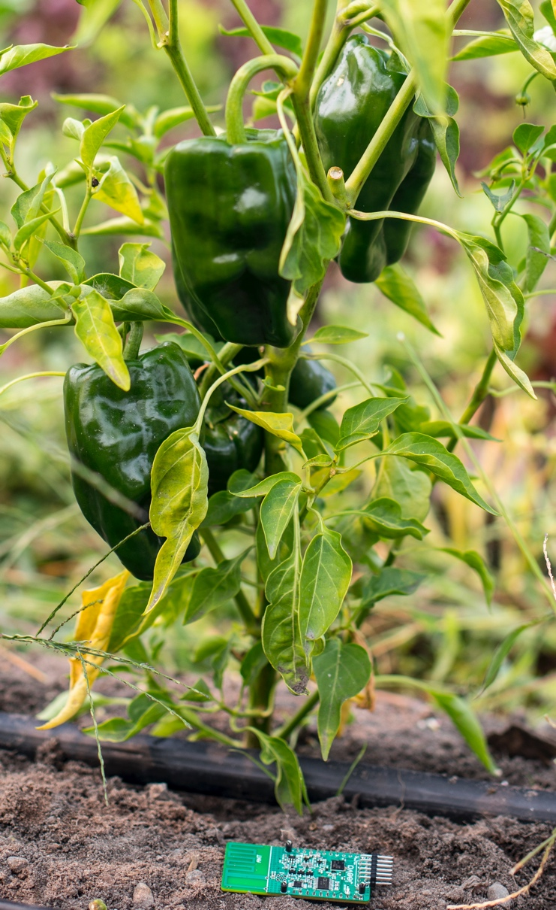
Precision Agriculture
Reliable communication across a 1 acre farm

Slide 19
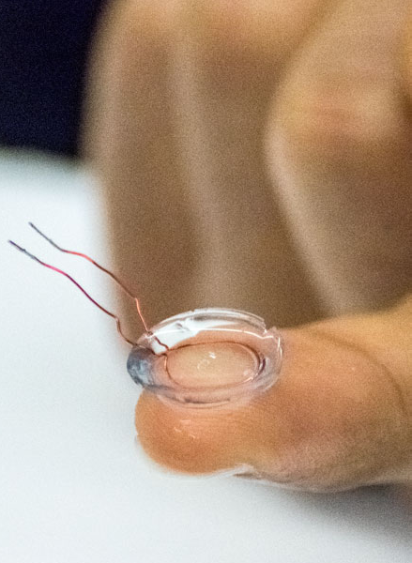
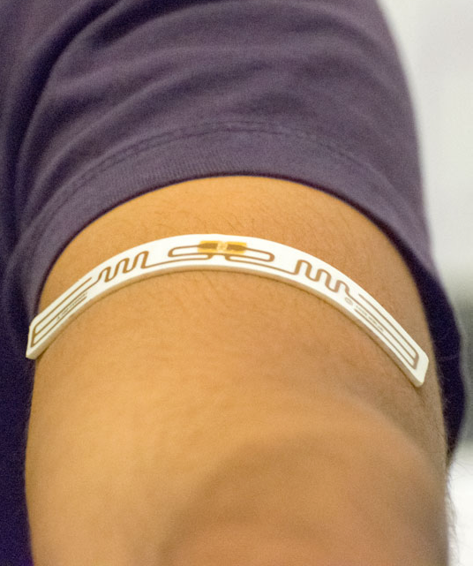
Implants & Flexible Medical Devices
Biological tissue attenuates RF and significantly detunes the antenna
Smart Contact Lens
Flexible Epidermal Patch

Slide 20
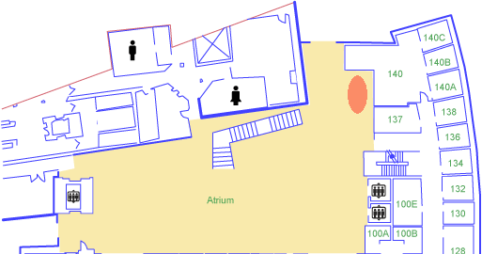
Smart Contact Lens & Flexible Epidermal Patch
Connectivity across the entire 3,328 ft² atrium
104 ft.
32 ft.
Tx
Rx

Slide 21
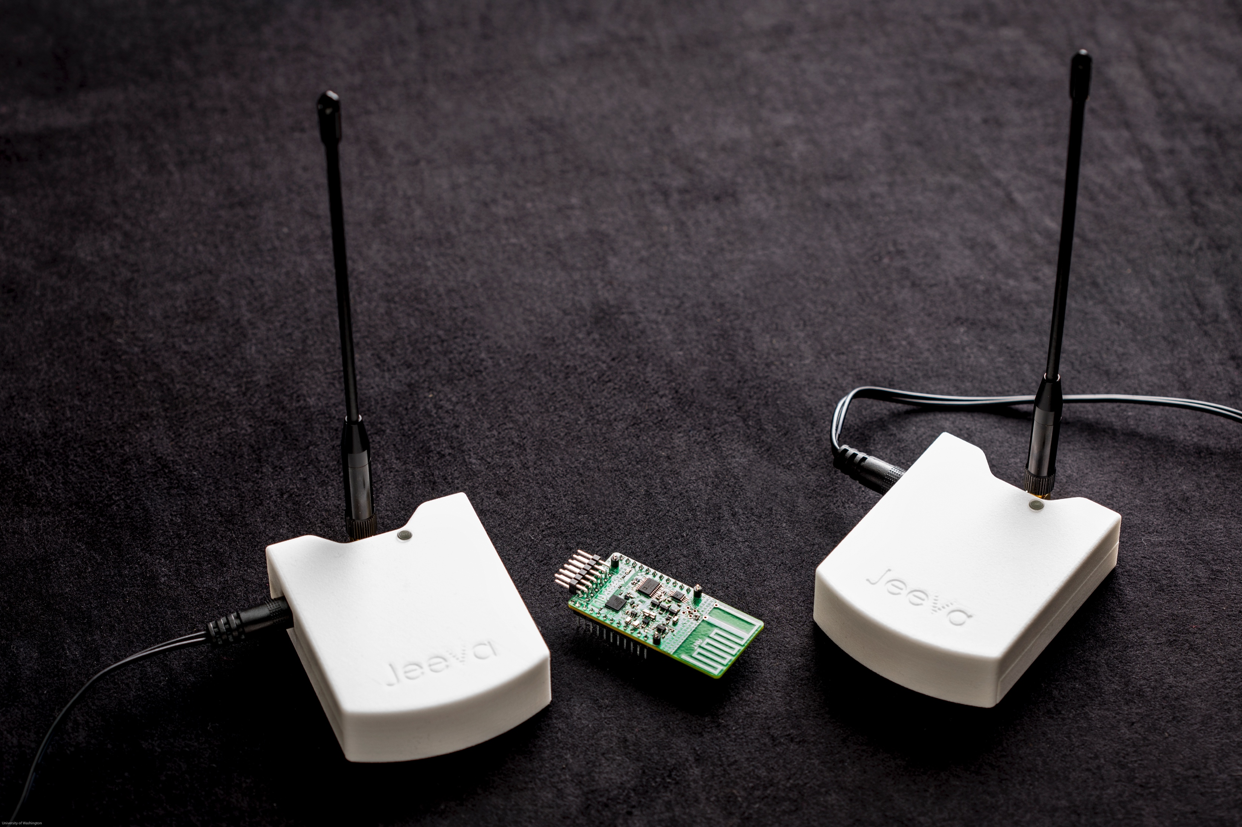
Conclusion
First wireless system that operates at km distances while consuming less than 10 µW.
Inexpensive flexible form factor connectivity solutions which can be integrated into everyday objects.
Demonstrate whole home coverage, agriculture and long range implanted medical applications.

Slide 22
jeevawireless.com
longrange.cs.washington.edu
Contact us at
info@jeevawireless.com

Slide 23
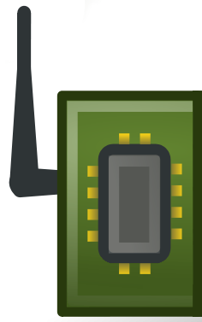
The case for backscatter communication
Power consumption
1000x – 10,000x lower than radios
Cost & Size
Small size with minimal analog front end
No external crystals or other components required
Battery technology
Low peak current: compatible with flexible printed battery technology
Extremely small, low power and cheap connectivity solution which can be embedded in every object

